Slide 1
Regress-itation
Feb. 5, 2015

Slide 2
Outline
Linear regression
Regression: predicting a continuous value
Logistic regression
Classification: predicting a discrete value
Gradient descent
Very general optimization technique

Slide 3



Regression wants to predict a continuous-valued output for an input.
Data:
Goal:
Notes:
Given a set of labeled training examples: d-dimensional x vectors and an associated real-valued output y for each, we want to learn a function f that maps input X to output Y.
We assume y is a function f of input x, plus some zero-mean noise.

Slide 4
Linear Regression

Slide 5
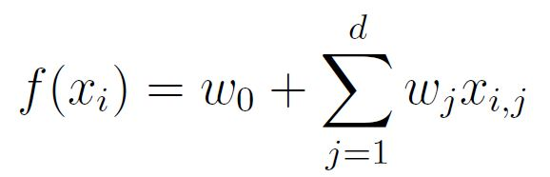
Linear regression assumes a linear relationship between inputs and outputs.
Data:
Goal:
Notes:
Given a set of labeled training examples: d-dimensional x vectors and an associated real-valued output y for each, we want to learn a function f that maps input X to output Y.
We assume y is a function f of input x, plus some zero-mean noise.
Linear regression assumes f is a linear function of x.

Slide 6
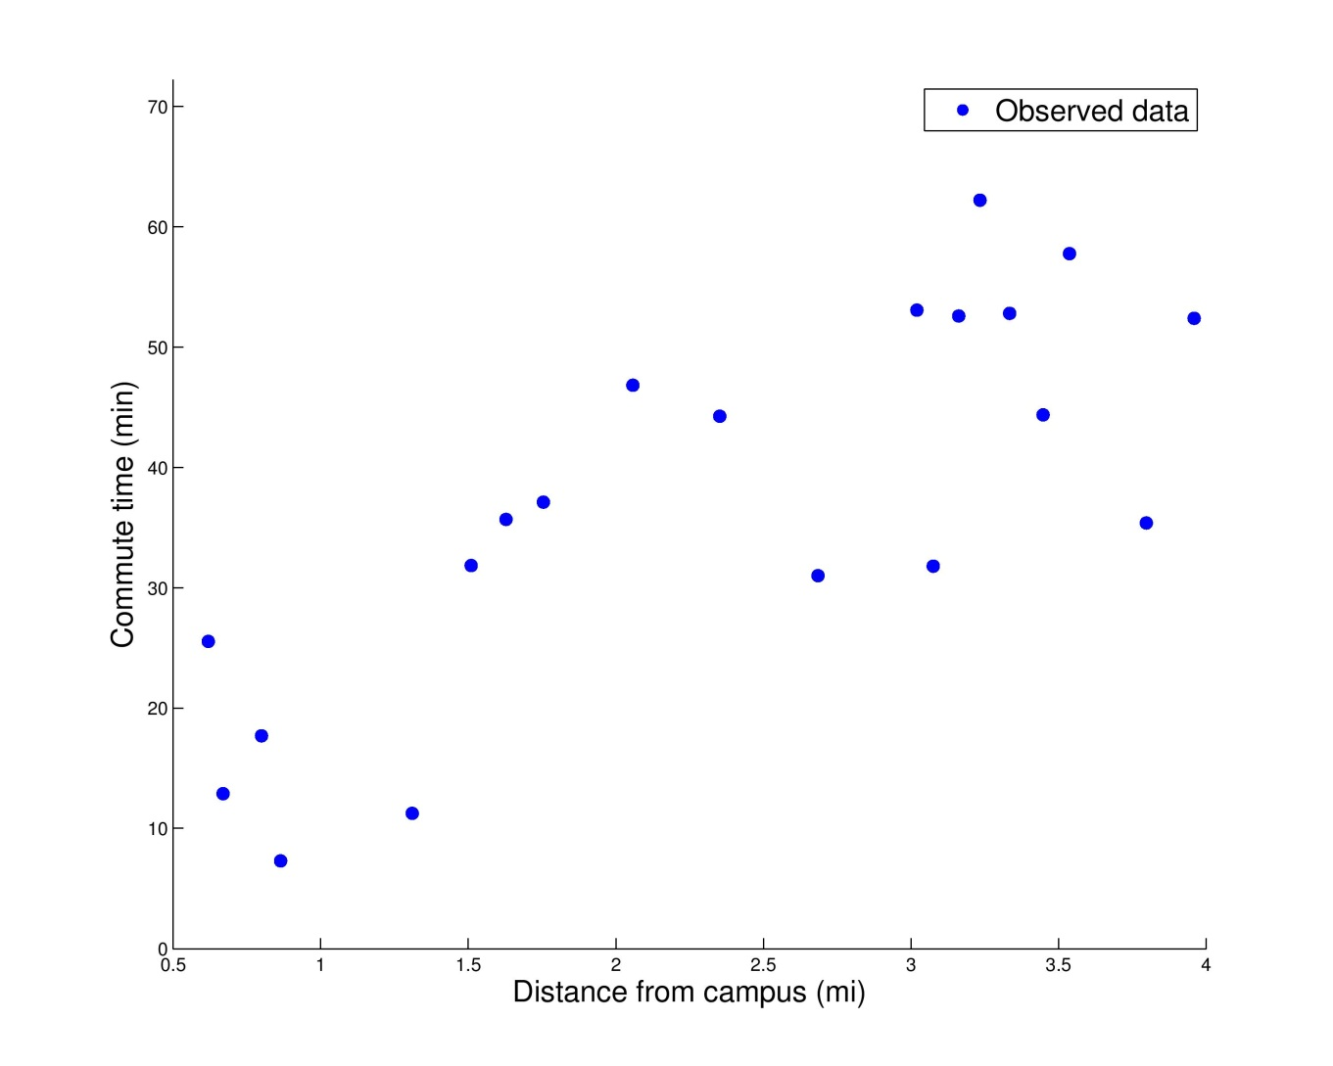
You collected data about commute times.
Notes:
Let’s talk about an example…
X axis – distance from campus (in miles)
Y axis – time to walk (in minutes)

Slide 7
Now, you want to predict commute time for a new person, who lives 1.1 miles from campus.
Notes:
Any ideas….?

Slide 8
Now, you want to predict commute time for a new person, who lives 1.1 miles from campus.
1.1
Notes:
Try looking at points nearby…

Slide 9
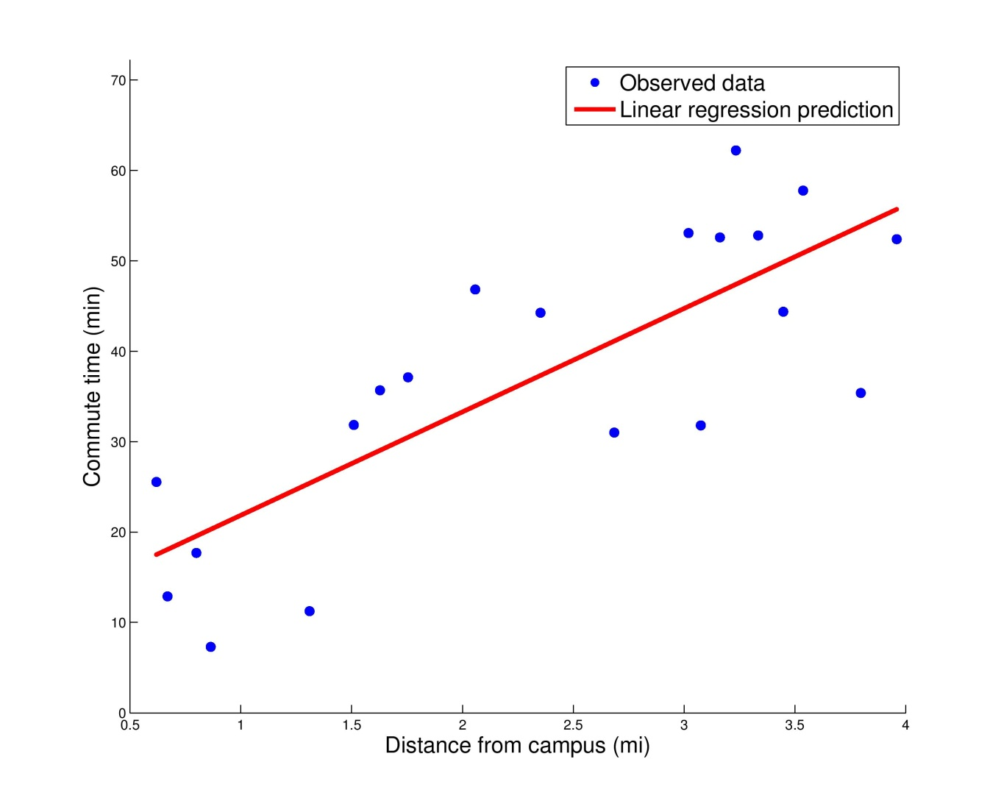
Now, you want to predict commute time for a new person, who lives 1.1 miles from campus.
~23
1.1
Notes:
Observed points seem to fit a general trend – if we could find this line, we could easily make a prediction for any point.
Looks like it would take this new person about 23 minutes to walk to CMU.

Slide 10
How can we find this line?

Slide 11
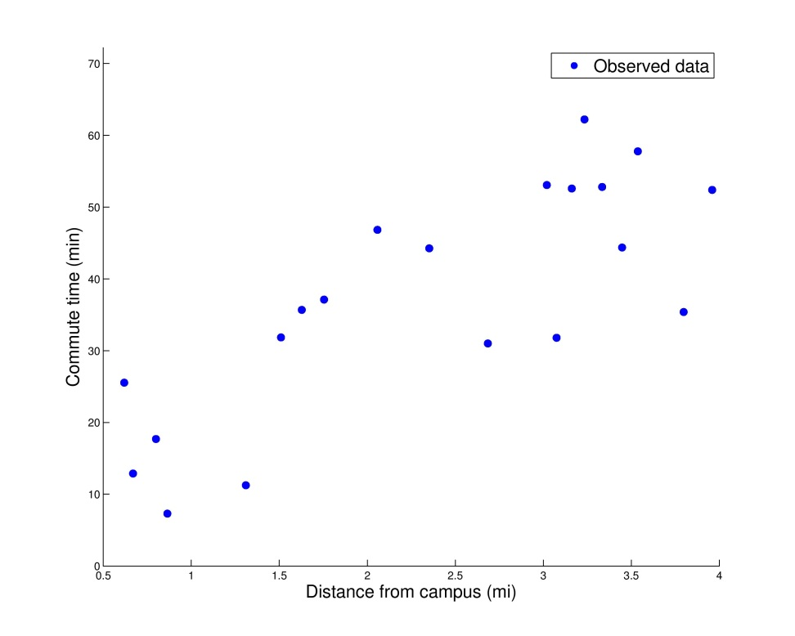
How can we find this line?
Define
x_{i}: input, distance from campus
y_{i}: output, commute time
We want to predict y for an unknown x
Assume
In general, assume y = f(x) + ε
For 1-D linear regression, assume f(x) = w₀ + w₁x
We want to learn the parameters w

Slide 12
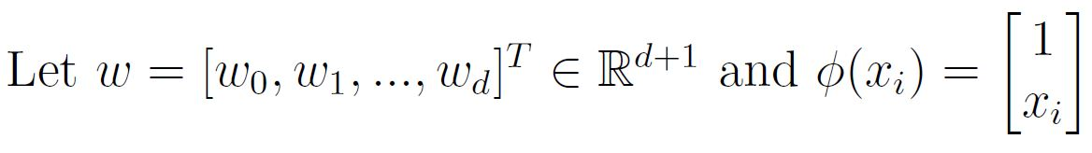
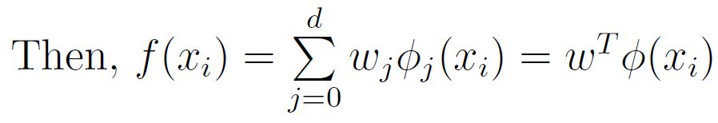
We can learn w from the observed data by maximizing the conditional likelihood.
Recall:
Introducing some new notation…
Notes:
Recall…
New notation for mathematical convenience/succinctness

Slide 13
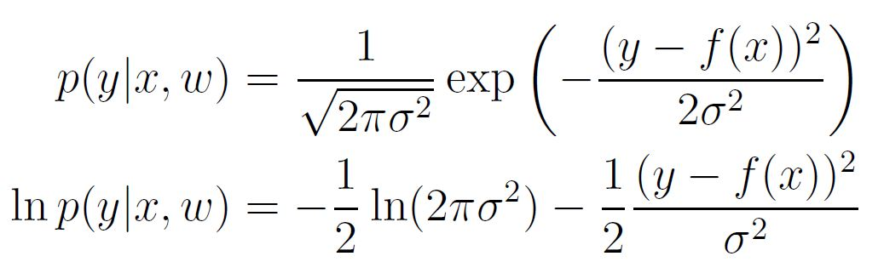
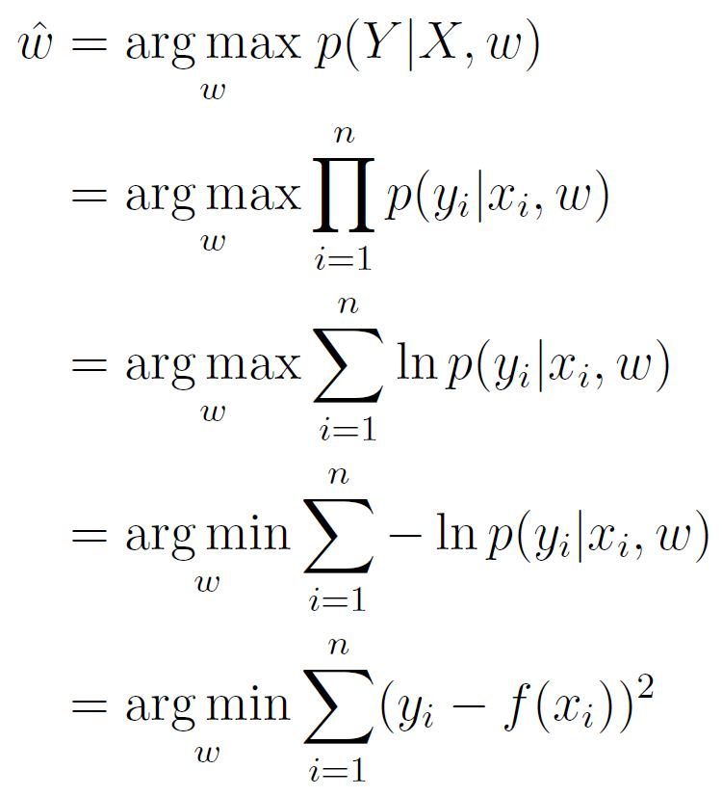
We can learn w from the observed data by maximizing the conditional likelihood.
Notes:
Now let’s figure out the likelihood

Slide 14
We can learn w from the observed data by maximizing the conditional likelihood.
minimizing least-squares error
Notes:
Now let’s figure out the likelihood
How can we solve this optimization?
Tom’s slides show gradient descent derivation.
It’s also possible to derive a closed-form estimate for w, but that’s a hw question, so won’t derive here.

Slide 15
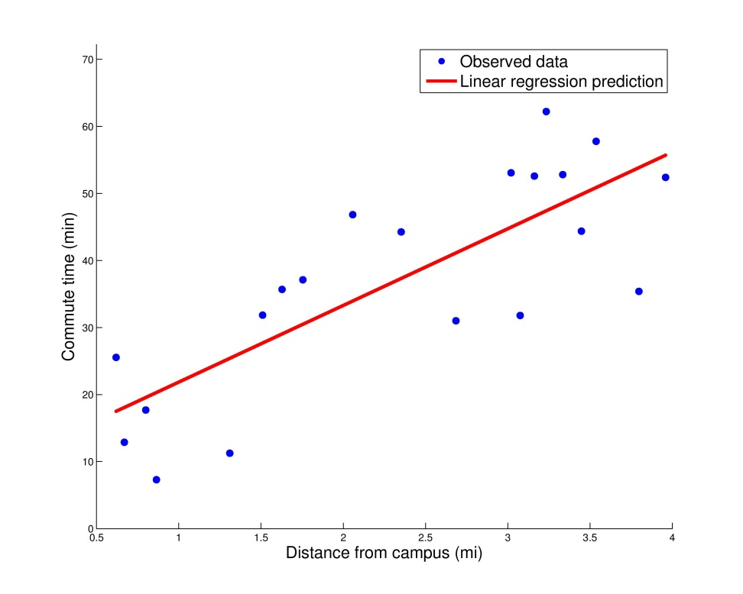
For the 1-D case…
Two values define this line
w₀: intercept
w₁: slope
f(x) = w₀ + w₁x

Slide 16
Logistic Regression

Slide 17
Logistic regression is a discriminative approach to classification.
Classification: predicts discrete-valued output
E.g., is an email spam or not?

Slide 18
Logistic regression is a discriminative approach to classification.
Discriminative: directly estimates P(Y|X)
Only concerned with discriminating (differentiating) between classes Y
In contrast, naïve Bayes is a generative classifier
Estimates P(Y) & P(X|Y) and uses Bayes’ rule to calculate P(Y|X)
Explains how data are generated, given class label Y
Both logistic regression and naïve Bayes use their estimates of P(Y|X) to assign a class to an input X—the difference is in how they arrive at these estimates.

Slide 19
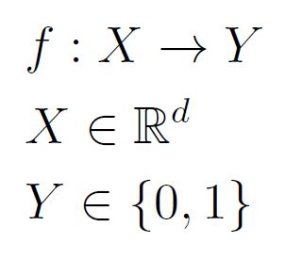
The assumptions of logistic regression
Given
Want to learn
Want to learn p(Y=1|X=x)

Slide 20
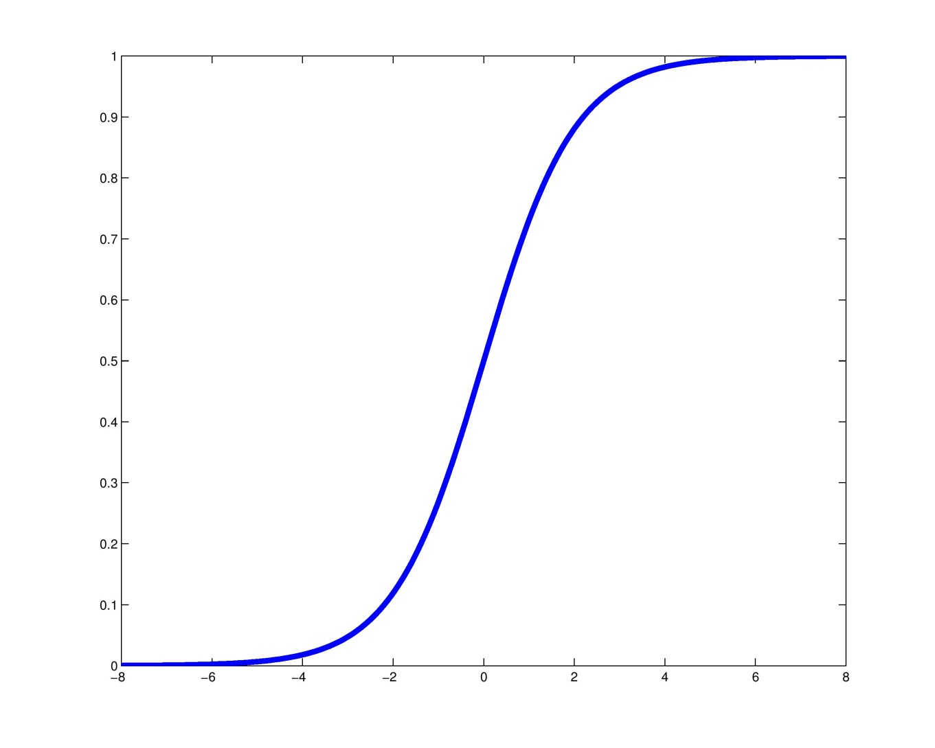
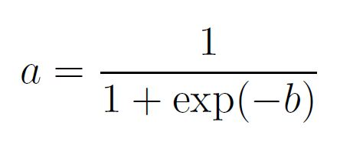
The logistic function is appropriate for making probability estimates.
a
b
Notes:
Between 0 and 1
Domain is all real numbers

Slide 21

Logistic regression models probabilities with the logistic function.
Want to predict Y=1 for X when P(Y=1|X) ≥ 0.5
Y = 1
P(Y=1|X)
Y = 0
Notes:
Another way to think about this is…

Slide 22
Logistic regression models probabilities with the logistic function.
Want to predict Y=1 for X when P(Y=1|X) ≥ 0.5
Y = 1
P(Y=1|X)
Y = 0

Slide 23
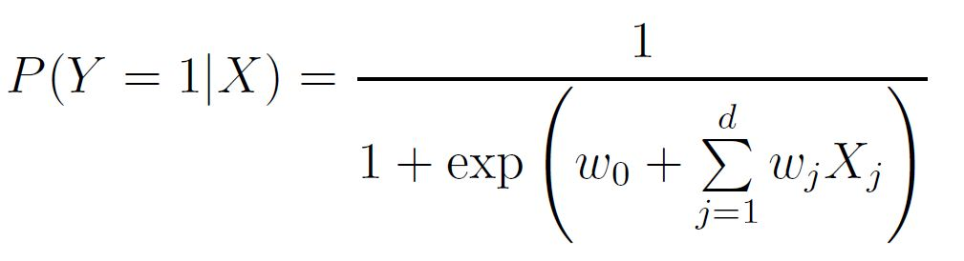
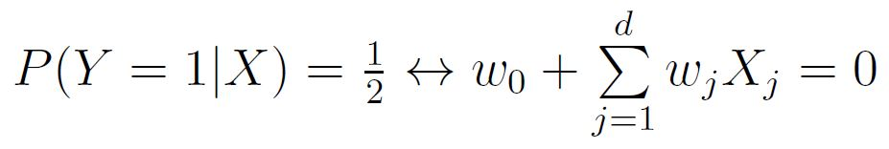
Therefore, logistic regression is a linear classifier.
Use the logistic function to estimate the probability of Y given X
Decision boundary:
Notes:
Model probability with logistic function
Then, the decision boundary (switch from classifying y=1 to y=0) is at p=0.5; equiv to w^Tx = 0 – a line
Classification depends entirely on this set of weights…how can we calculate them from the data?

Slide 24
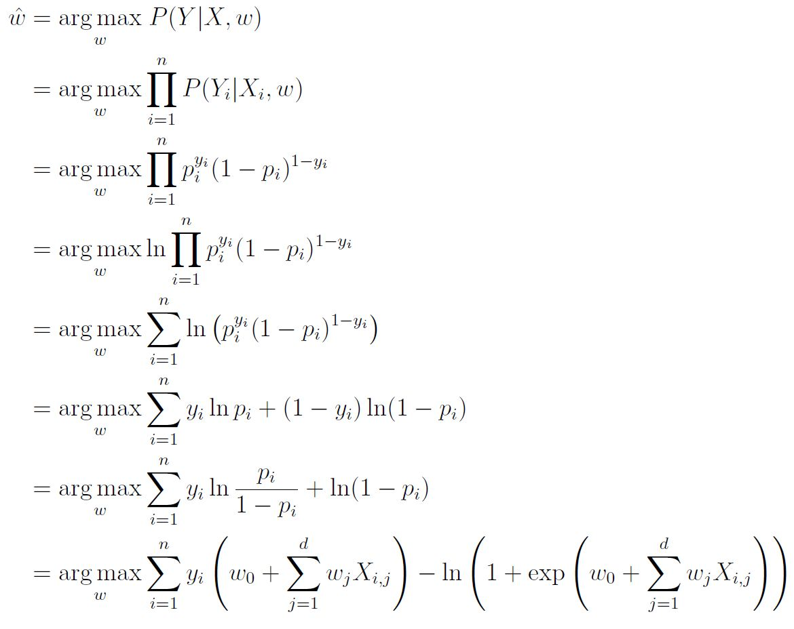
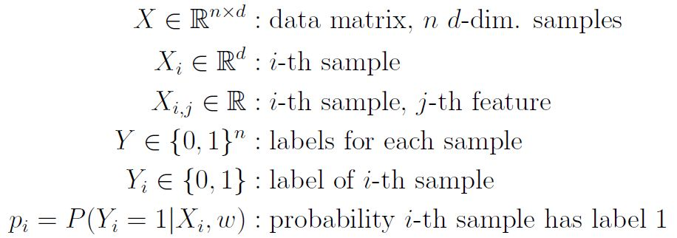
Maximize the conditional likelihood to find the weights w = [w₀,w₁,…,w_{d}].

Slide 25
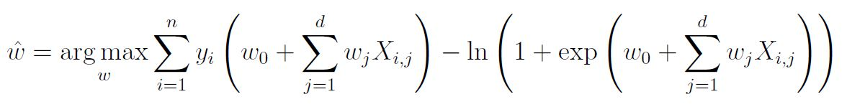
How can we optimize this function?
Concave ☺ [check Hessian of P(Y|X,w)]
No closed-form solution for w ☹
Notes:
Concave – unique maximum
Usual approach would be to differentiate function, set to zero, and solve for optimal w

Slide 26
Gradient Descent

Slide 27


Gradient descent can optimize differentiable functions.
Suppose you have a differentiable function f(x)
Gradient descent
Choose starting point $x^{(0)}$
Repeat until no change:
Updated value
for optimum
Previous value
for optimum
Step size
Gradient of f,
evaluated at
current x
Notes:
Taking steps in direction of gradient
Descent = minimize
Ascent = maximize
Same idea

Slide 28
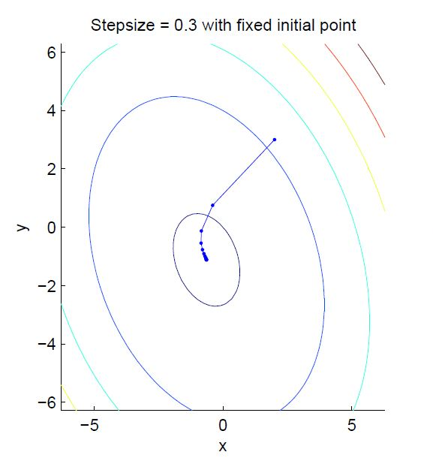
Here is the trajectory of gradient descent on a quadratic function.

Slide 29
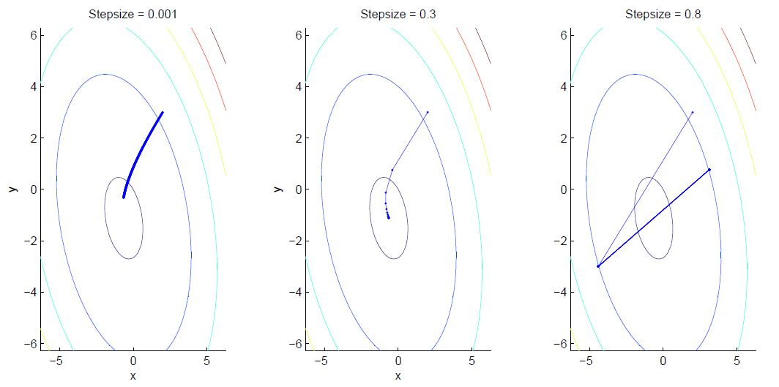
How does step size affect the result?
Notes:
Too big: keep overshooting, bounce back and forth, never reach optimum.
Too small: Can’t reach optimum in a fixed number of steps – takes longer to converge.
There are some techniques for finding a good step size – can change step size at each iteration.

Slide 30
Gradient descent can optimize differentiable functions.
Suppose you have a differentiable function f(x)
Gradient descent
Choose starting point $x^{(0)}$
Repeat until no change:
Updated value
for optimum
Previous value
for optimum
Step size
Gradient of f,
evaluated at
current x
Notes:
Taking steps in direction of gradient

